Slide 1
White Paper on Hashing Algorithms and IPFS
Created by: Chenna Kesav Daggubati
ICS-690 Blockchain

Slide 2
Table of contents
Cryptographic concepts
Cryptographic algorithms
Additional concepts
Hashing Algorithms
Other methods
Keccak
Sponge function
History of cryptocurrency mining
Purpose of using different algorithms
Scrypt Algorithm
X11
Ethash
IPFS

Slide 3
Cryptography concepts related to blockchain Technology
Block: collections of data
Chain: lists which are public databases of blocks
Cryptography is also composed of two ancient Greek words: Kryptos means Hidden and Graphein means write
Encryption: converting plaintext to cipher text and decryption
Cipher: cryptographic algorithm used
Key is required to get the output of the algorithm

Slide 4
Cryptographic algorithms
Symmetric cryptography
Same key is used to encrypt and decrypt the data
Asymmetric
Two different keys public and private keys are used
Hash functions
Don’t require keys
Generates a fixed length has from given input
Properties: Avalanche effect(slight change gives different output), uniqueness, deterministic(same input have same outp, and quickness
Links blocks to one another
Helps maintain integrity stored in each block
Blockchains uses asymmetric key algorithms and hash functions

Slide 5
Additional Benefits of cryptographic concepts
Digital signature
Provides integrity and authenticity validation of data
Multi-signatures algorithm
Generates digital signatures where it requires multiple parties to be valid
Zero knowledge proof
Helps user prove knowledge of a secret without revealing the secret itself
Stealth addressing
Anonymizes the recipient side of a transaction by generating a one-time address and claiming the value
It's possible to know the value in the wallet
Ring signature
Anonymizes the sender
Allows someone as a member of the group to sign data using set of public keys which generates a signature
Signer should have a private key which verifies he is member of group

Slide 6
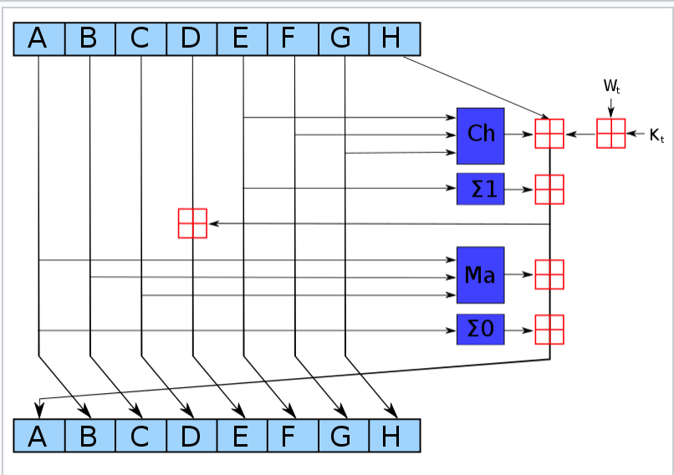
Hashing Algorithms
Set of algorithms developed by the National Institutes of Standards and Technology(NIST) and other government and private parties
Hashes are commonly shown in Hexadecimal format
MD2, MD4
128-bit(32 hexadecimal characters) hash value is generated by MD5 or the Message-Digest algorithm : https://en.wikipedia.org/wiki/MD5
NSA created SHA-0, SHA-1, SHA-2
SHA-1(160 bit hash):Updtaed version of MD5 and not collusion resistant, Cracked by google in 2015 using distributed computing,
SHA-2: made by National Security Agency
Consists of six hash functions with digests
Includes significant changes from SHA-1
SHA-256 creates 256 bit hashes, SHA-512 creates 512 bit hash
SHA-224 and SHA-384 created truncated versions of 256, 512

Slide 7
Other Methods
HMAC - Hash based Message authentication code
Fixed length string of bits similar to MD5 and SHA-1
Known as HMAC-MD5 and HMAC-SHA1
Uses shared secret key to add randomness to result
Only sender and receiver knows the secret key
Key stretching
Salts the password with extra bits to make it complex
PBKDF2 uses salts of at least 64 bits
Uses pseudo random function such as HMAC to protect passwords

Slide 8
Keccak
SHA-3 was created outside of NSA, was selected in non-NSA public competition
SHA-3 also known as Keccak won the NIST competition based on throughput and energy consumption by algorithm
It can create hashes of same size as SHA-2.
Became the official SHA3 but with a small difference from keccak while padding
Employed by Monero
But not for Proof-of-Work
Used for
Random number generator(crypto zombies first module)
Block hashing
Transaction hashing
Stealth address private key image
Public address checksum
Authentication

Slide 9
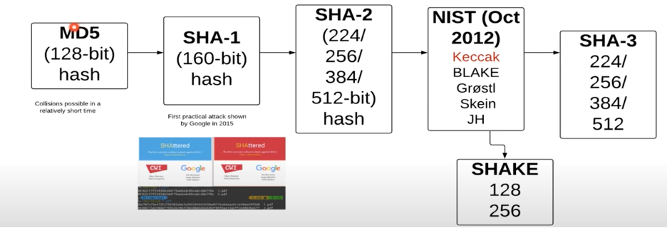
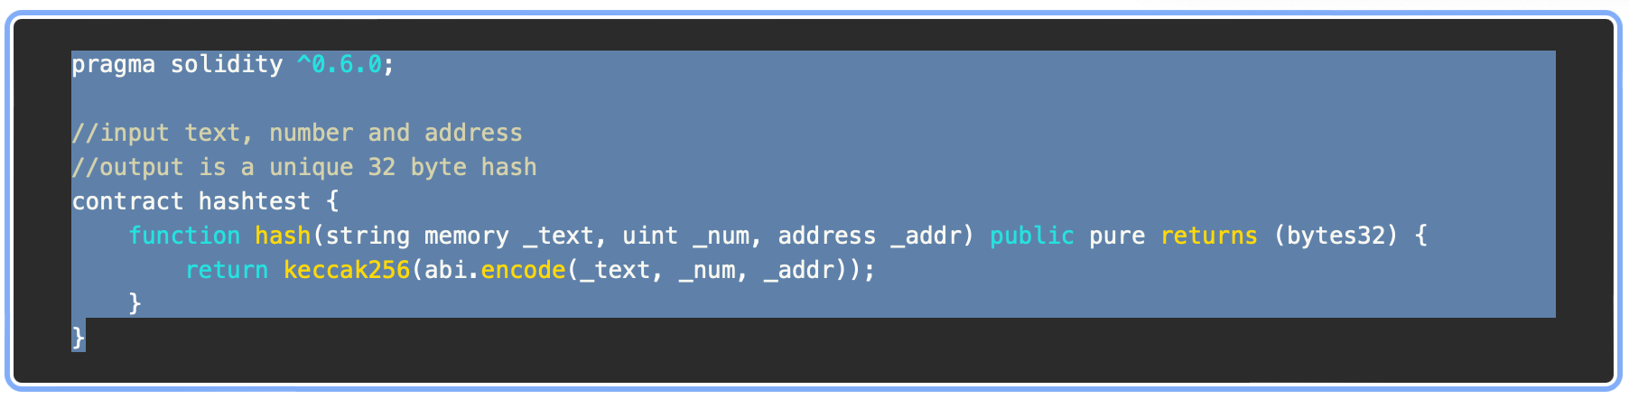

Slide 10
Sponge function
Takes an input bit stream of any length
Produce an output bit stream of any desired length
Built from 3 components
State memory
Two sections: R and C
Two phases: absorbing phase + squeezing phase
Function that transforms the state memory
Padding function P

Slide 11
Keccak process
Keccak is more powerful because of its state size of 1600 bits
Advanced Encryption standard(AES) operates on 4*4 column major order array of bytes known as state https://en.wikipedia.org/wiki/Advanced_Encryption_Standard
Break data into r bits chunks
EX-OR it with the rate part of the state
Output feeds into the function (f)
24 rounds and is created with EX-OR, AND, and NOT functions
Feed it into the next stage if there is more data
Once all the message data is exhausted, we go into a squeezing function and produce an output (Y0)
Output is truncated to the required hash size or processed until the required output size is produced

Slide 12
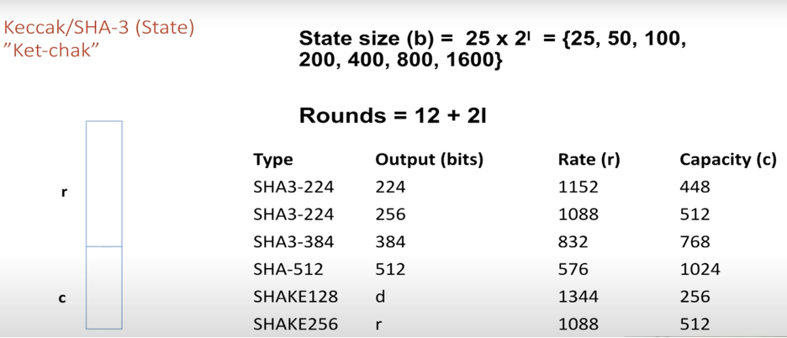
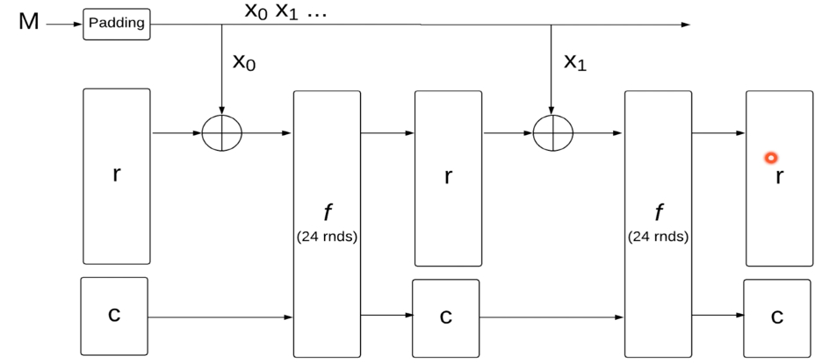

Slide 13
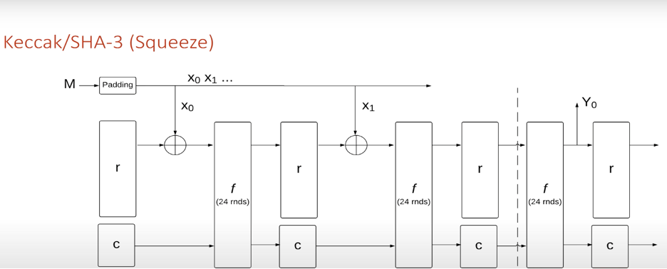

Slide 14
History of cryptocurrency mining
Began with Bitcoin (BTC) SHA256 algorithm → Litecoin Scrypt algorithm (LTC) → X11 → Dash and Ethash for Ethereum (ETH)
BTC, ETH, and LTC
3 mineable coins
Operate within the proof-of-work
Use different hashing algorithms
BTC uses SHA-256 hash function
ETH uses Ethash Proof of Work hashing algorithm
In the near future, it will switch over to Proof of Stake
LTC uses Scrypt algorithm

Slide 15
Purpose of using different algorithms
Resist purpose build hardware’s like Application Specific Integrated Circuits (ASICs) and Field Programmable Gate Arrays (FPGAs)
When cryptocurrency is ASIC resistant
No ASIC machine has been developed yet to mine the coin
The coin can only be mined using consumer grade hardware like CPU and GPUs
It is only a matter of time for someone to develop an ASIC for that coin

Slide 16
Scrypt Algorithm
Scrypt: password-based key derivation function (KDF)
KDFs: designed to be computationally intensive
Efficient at preventing brute attacks and Rainbow table attack
Scrypt offers
High level security
Improves network security by resisting large scale custom hardware attacks
SMIX : Hashing value in memory intensive way
Its ability to hinder ASIC mining machines it is considered to be the most effective alternative to Bitcoin’s SHA-256 hashing algorithm
Used by Litecoin and Dogecoin

Slide 17
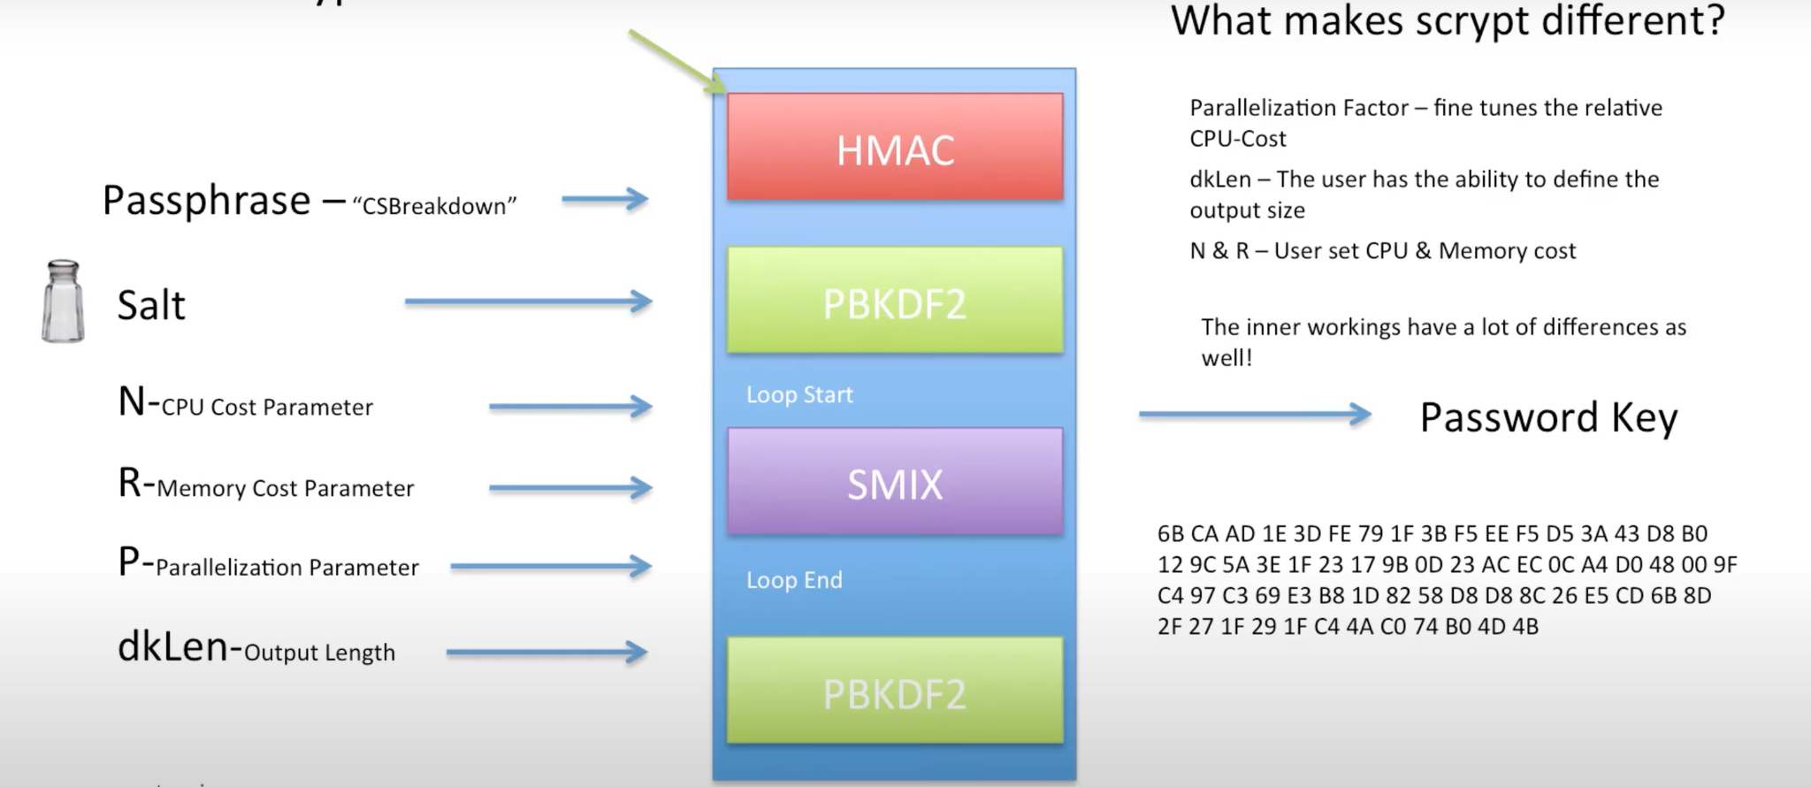
Scrypt Algorithm

Slide 18
X11
Designed for cyrptocyrrencies, Darkcoin protocol in 2014
More secure than SHA-256
Not used by ASICs
Most famous: Dash.X11
Uses 11 different hash algorithms such as BLAKE, BMW which qualified in NIST Competition
Probability of it failing is close to zero
How it works
When a value is submitted to the BLAKE function → produces a hash value
Value is submitted to the BMW function → produces another value
Process repeats until the last function
BLAKE made into the final five in the NIST open competition

Slide 19
Ethash
Proof-of-work function in Ethereum-based blockchain currencies
Hash function belonging to the Keccak family
Not a SHA-3 function
Developed as an upgrade of Dagger-Hashimoto to remove computational overhead
Dagger: uses Directed Acyclic Graph (DAG) https://en.wikipedia.org/wiki/Directed_acyclic_graph
Hashimoto: Random Access Memory (RAM)
ASIC resistant
Light Client Verifiability : a block should be relatively efficiently verifiable by a light client
List of a few mineable coins uses this algorithm based on popularity
ETH
Ethereum Classic
Metaverse ETP
Expanse
Musicoin

Slide 20
InterPlanetary File system(IPFS)
Decentralized internet similar to bittorrent
SHA-256 hashing algorithm by default
Issues with centralization
Centralized servers Ex: Youtube, Wikipedia, google
Censorship : government can block access Ex: Turkey 2017 Blocked Wikipedia
Why do people still use it
Fast and high quality
No good and fast alternative
Location based addressing vs Content based addressing(where to find vs what you want)
Based on the hash of the file
Data is stored in IPFS objects which can store upto 256kb and objects also contains links of another objects
Larger files are stored using empty IPFS object which has links of the ipfs objects related to file
IPFS also has version controlling

Slide 21
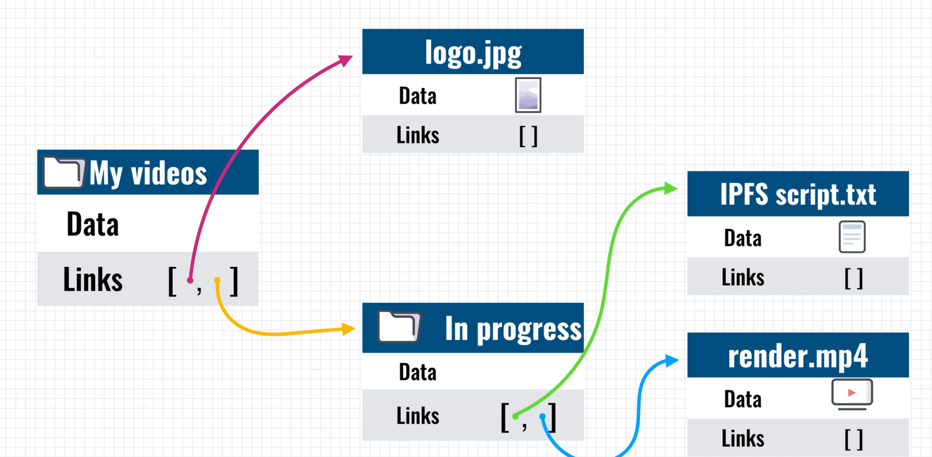
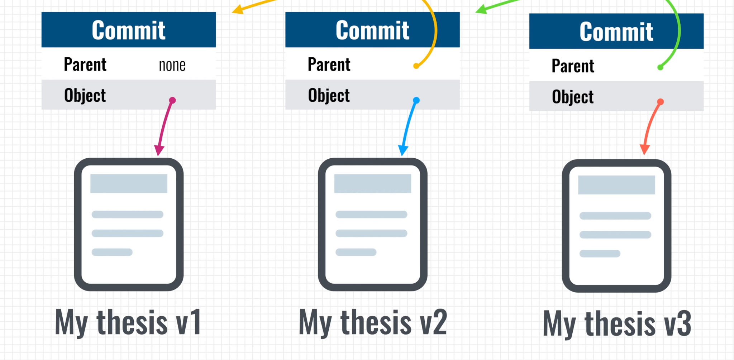

Slide 22
Problems with IPFS and Possible Solutions
Problem
Nodes being offline
Solutions
Incentivize nodes
Proactively distribute files
Filecoin is created by same people as IPFS: Decentralized market for storage
Provide incentives for keeping file online and it also help replicate files for better availability
Applications of IPFS
Hosted copy of Wikipedia on IPFS for people to access from Turkey in 2017
Dtube basically like youtube
Can this really support interplanetary ??

Slide 23
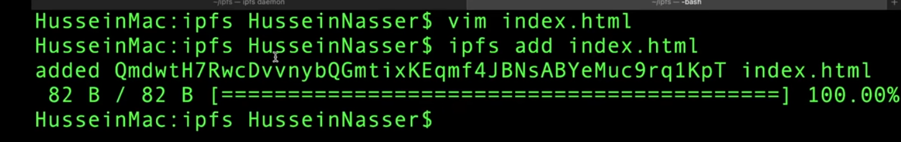
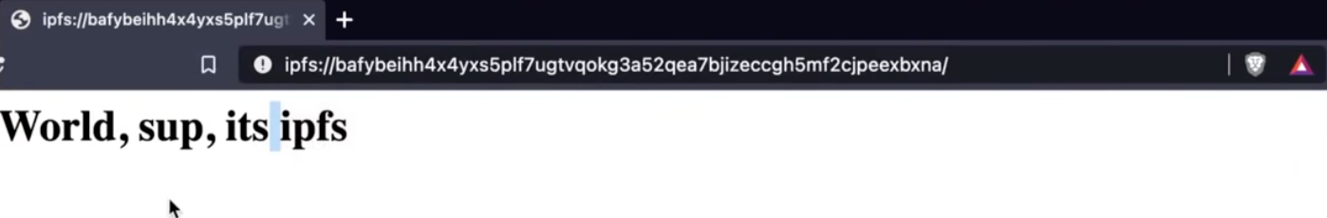
Routing
Hash which is known as content id
Distributed hash tables maps content id to peer address
DHT server(IPFS server) hosts DHT’s
DHT client (IPFS client) connects to DHT server
IPFS clients ask local DHT for Cid and retrieves collection of ip address
If nothing returns it asks its peers

Slide 24
Learnings from this Class
Fundamentals of blockchain : https://github.com/Maghribi-Foundation/chennakesavdaggubati/blob/main/Blockchain%20Notes.md
Crypto zombies
How to write solidity code
Chitfund Project
Metamask, deployment of existing project, capitalization
In-depth analysis of Cryptographic concepts
Hashing Algorithms
IPFS
How to use it in my thesis

Slide 25
References
https://github.com/ethereum/wiki/wiki/Dagger-Hashimoto
https://eth.wiki/en/concepts/ethash/ethash
https://asecuritysite.com/hash/s3
https://asecuritysite.com/hash/gokang
https://asecuritysite.com/hash/goshake
https://zerocrypted.com/what-is-ethash/
https://coinguides.org/asic-resistance-explained/
https://medium.com/asecuritysite-when-bob-met-alice/one-of-the-greatest-advancements-in-cybersecurity-the-sponge-function-keccak-and-shake-6e6c8e298682
https://www.youtube.com/watch?v=bTOJ9An9wpE&t=2s
https://en.wikipedia.org/wiki/NIST_hash_function_competition
https://www.mycryptopedia.com/x11-algorithm-explained/
https://monerodocs.org/cryptography/keccak-256/
https://cryptoadventure.com/blockhain-hashing-algorithms-explained-all-you-need-to-know/
https://coinguides.org/scrypt-coins/
https://www.youtube.com/watch?v=PlvMGpQnqOM&t=6s
https://www.youtube.com/watch?v=TkWAgeSYL_Q

Slide 26
Thank you for listening!
Questions????????????????????????????????????

